Slide 1
Fabric Automated Deploy Guidance
Deploying and Updating Multitenant Solutions in Fabric

Slide 2
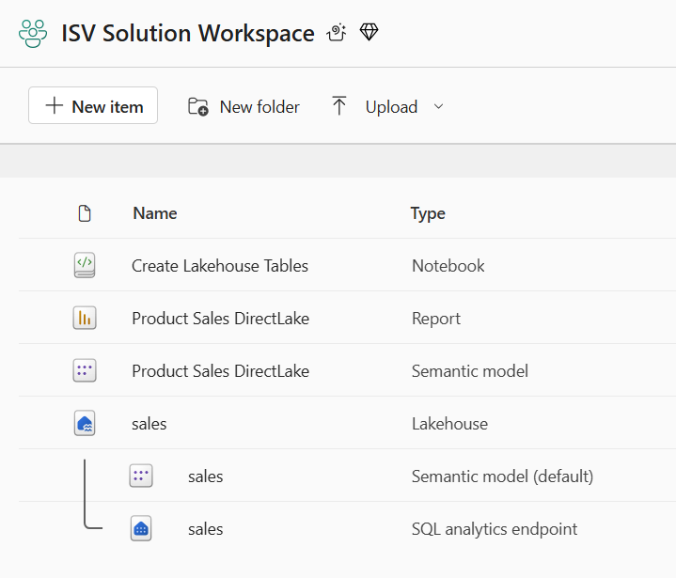
Designing Fabric Solutions for Multitenant Environments
Design workspace to serve as workspace template to provision customer tenants
Current PoC limits workspace items to lakehouses, notebooks, semantic models and reports
Implement deployment workflow to create workspaces from workspace template
Execute deployment workflow to create customer tenants
Customer 1
Workspace
Solution Deployment Logic
Implemented using Fabric REST APIs
Customer 2
Workspace
Customer 3
Workspace

Slide 3
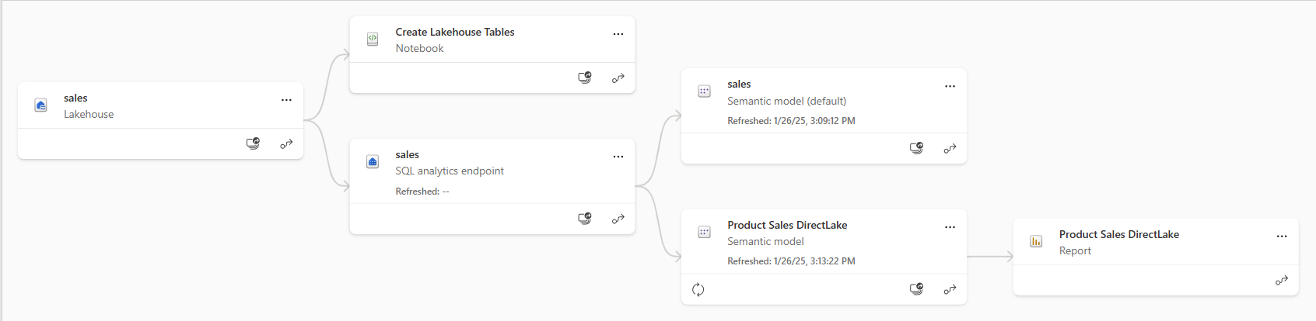
Understanding Workspace Item Dependencies
Many workspace items have dependencies on other workspace items
Notebook definition depends on workspace id and lakehouse id for its default lakehouse
DirectLake semantic model definition depends on connection string to SQL endpoint of lakehouse
Report definition depends on semantic model id

Slide 4
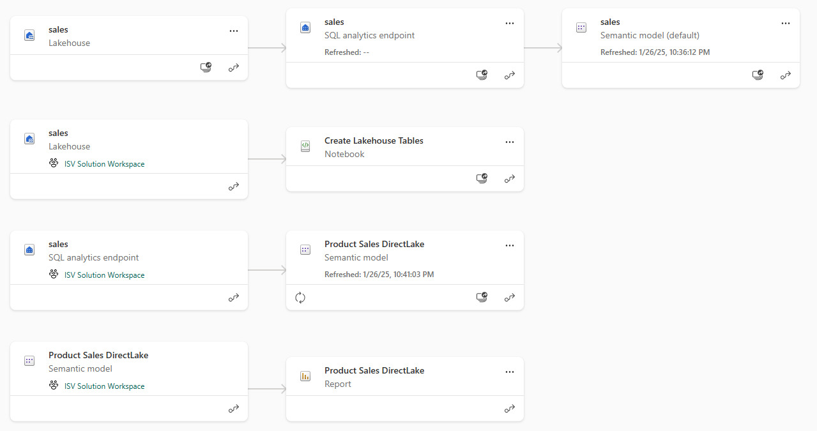
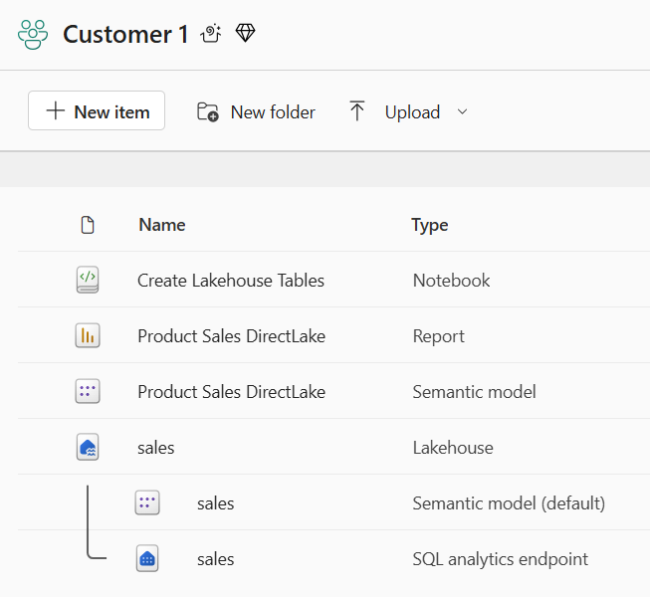
Creating Workspace Items with Dependencies
Design workflow to create workspace items with dependencies last
Notebook definition depends on lakehouse id for its default lakehouse
DirectLake semantic model definition depends on connection string to SQL endpoint of lakehouse
Report definition depends on semantic model id
Shallow copy of template workspace is not the result you want
Workspace for customer tenant should not have dependencies on template workspace

Slide 5
Customer Tenant Workspaces Should Avoid External Dependencies
Items in new workspace should not have dependencies on template workspace items
Dependencies on items should be limited to other items in same workspace

Slide 6
Sequence of Steps in Solution Deployment Workflow
Create lakehouses
Lakehouse has no dependencies on other workspace items
After creation, track lakehouse id for later use
Query lakehouse properties to discover SQL endpoint connect string
Create notebooks
Create notebook using item definition that includes workspace id & lakehouse id
After creation, run notebook and monitor execution until completion
Create DirectLake semantic models
Create semantic model using updated item definition that includes SQL endpoint connect string
After creation, track semantic model id for later use
After creation, create & bind connection and then refresh semantic model
Create Power BI reports
Create report using updated item definition that includes semantic model id

Slide 7
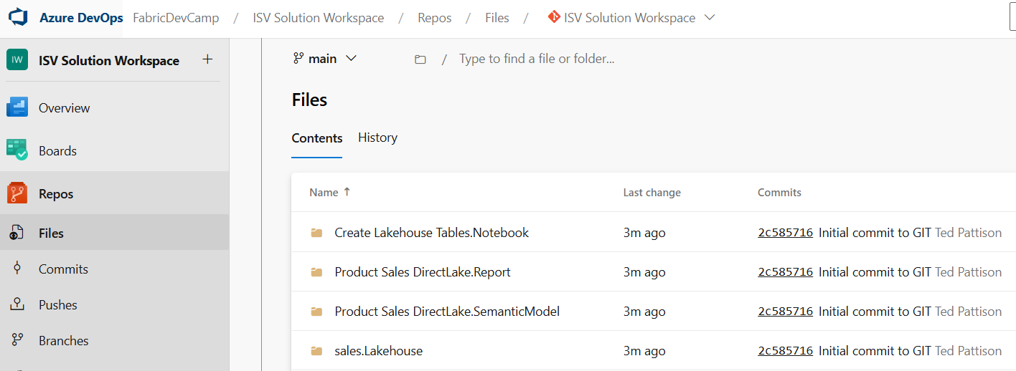
Connecting Fabric Workspace to GIT Repositories
Fabric workspace can be connected to GIT repository
Fabric currently supports GIT repositories in Azure Dev Ops and GitHub
Workspace connections can be configured by hand or through Fabric REST APIs
Once connected, workspace items serialized as item definition files in GIT repository
GIT connection to workspace provides 2-way synchronization
Changes made to workspace items can be synchronized to GIT repository files
Changes committed to GIT repository files can be synchronized to workspace items
GIT
Sync

Slide 8
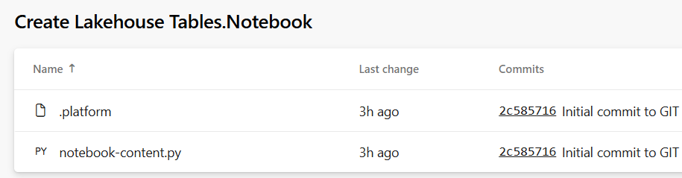
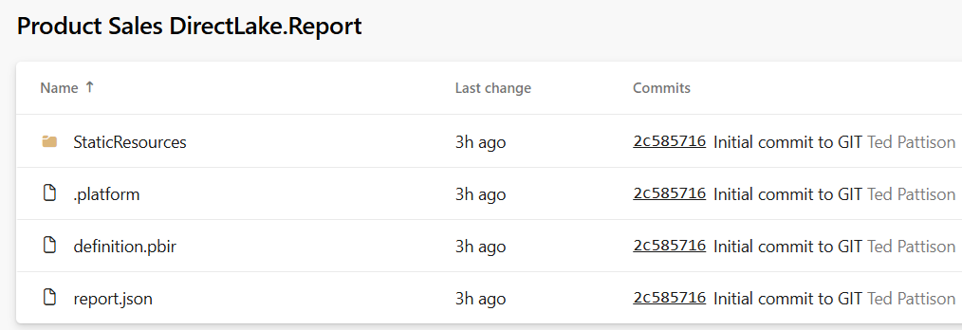
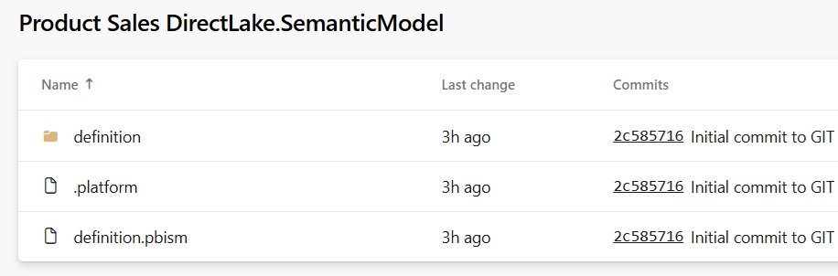
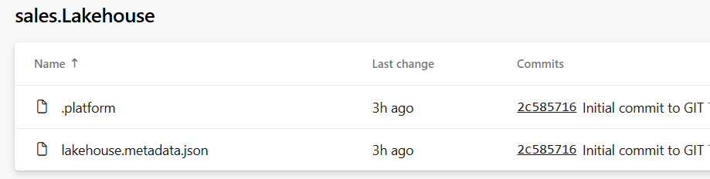
Item Definition Files
Fabric ALM strategy with CI/CD based on item definition files
Fabric automatically serializes workspace items into set of item definition files
Each type of workspace item defines the set of files that constitutes a valid item definition
eee

Slide 9
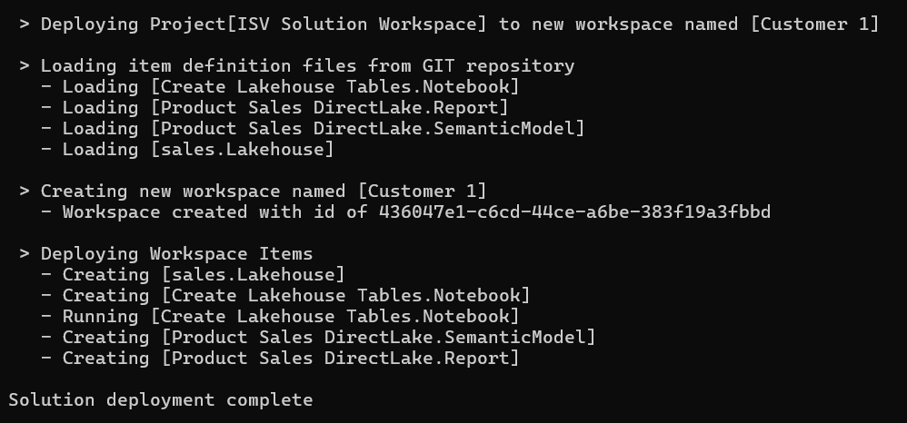
Deploy Solution
Deploy Solution Logic
Implemented Using Fabric REST APIs

Slide 10
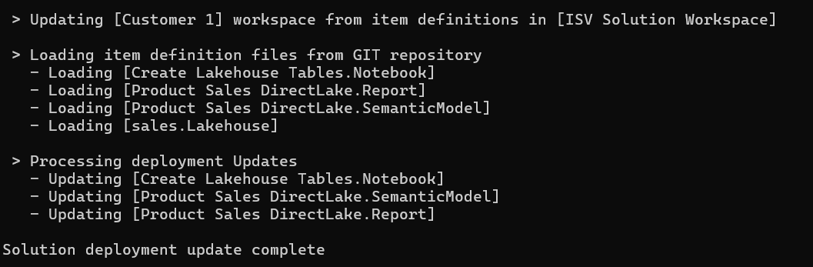
Update Solution
Update Solution Logic
Implemented Using Fabric REST APIs

